Slide 1
NFC Pedometer & Location Based Social Game for Tourists
Nakayama Angelica

Slide 2
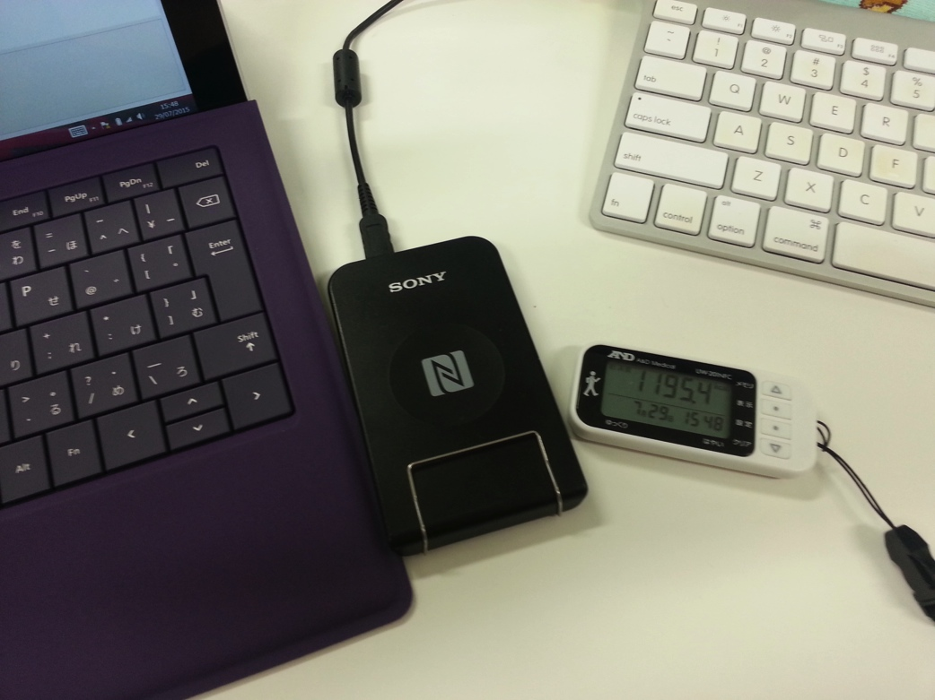
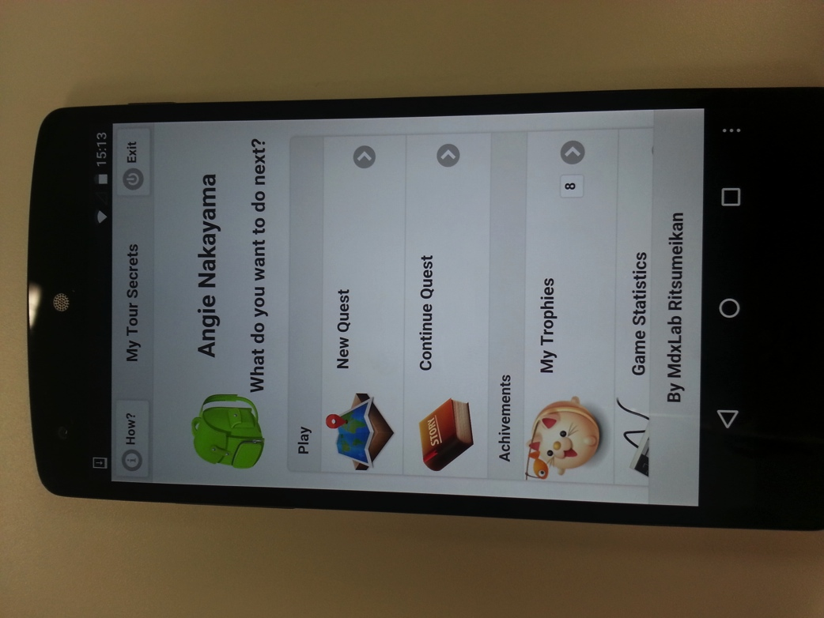
NFC Pedometer
Location Based Social Game for Tourists
for Tekupeko project
Notes:
Explain why 2 projects…

Slide 3

NFC Pedometer for Tekupeko walking project
Tekupeko is a project for making people walk more using mobile technologies (smartphones).
This project was developed in Multimedia Experience Laboratory (by Suzuki san and Wakao san) it was used last year (and also this year) on a walking for health event.
Android and iPhone app already developed and in phase of redesign and improvement.
There is also a webpage where you can register and see your progress, make teams, etc.

Slide 4
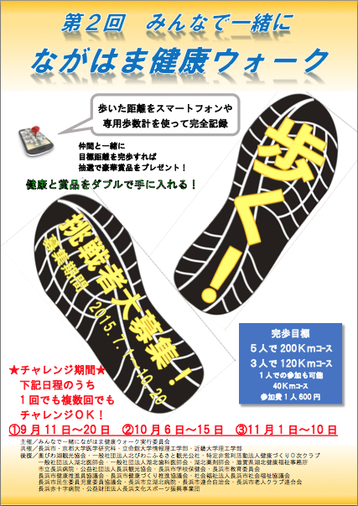
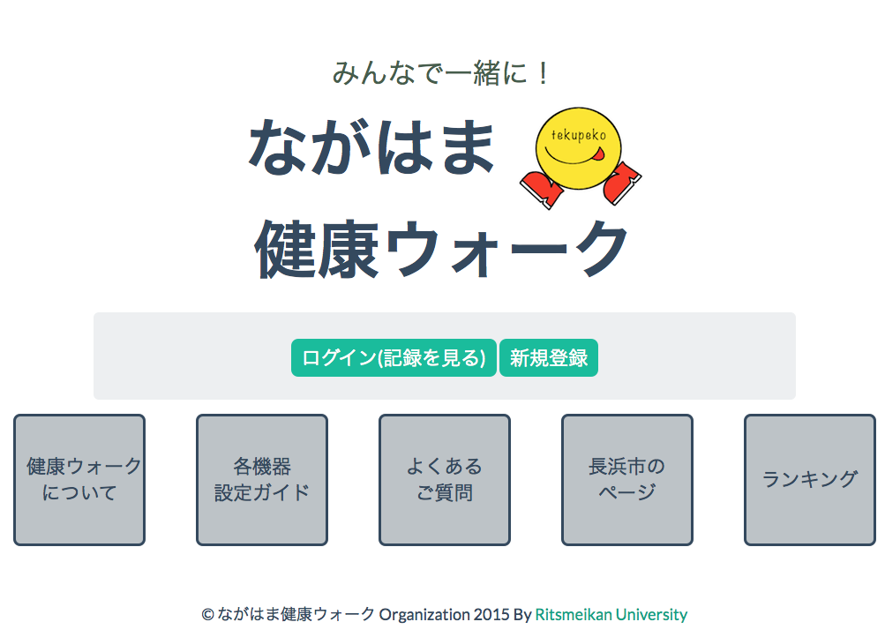
Web page and event promotion flyer

Slide 5

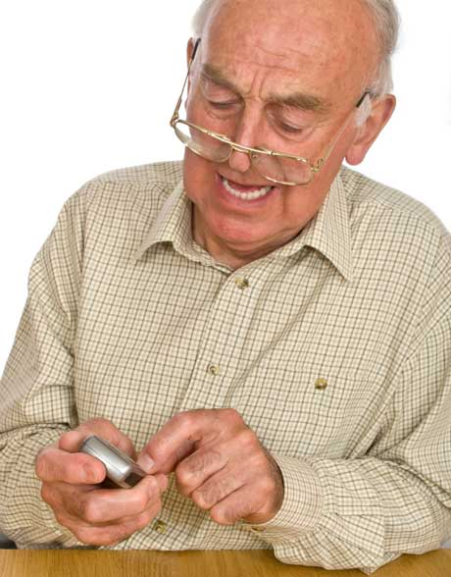
But what about people without smartphones?
Older people, kids, etc. How can they participate on this event????

Slide 6
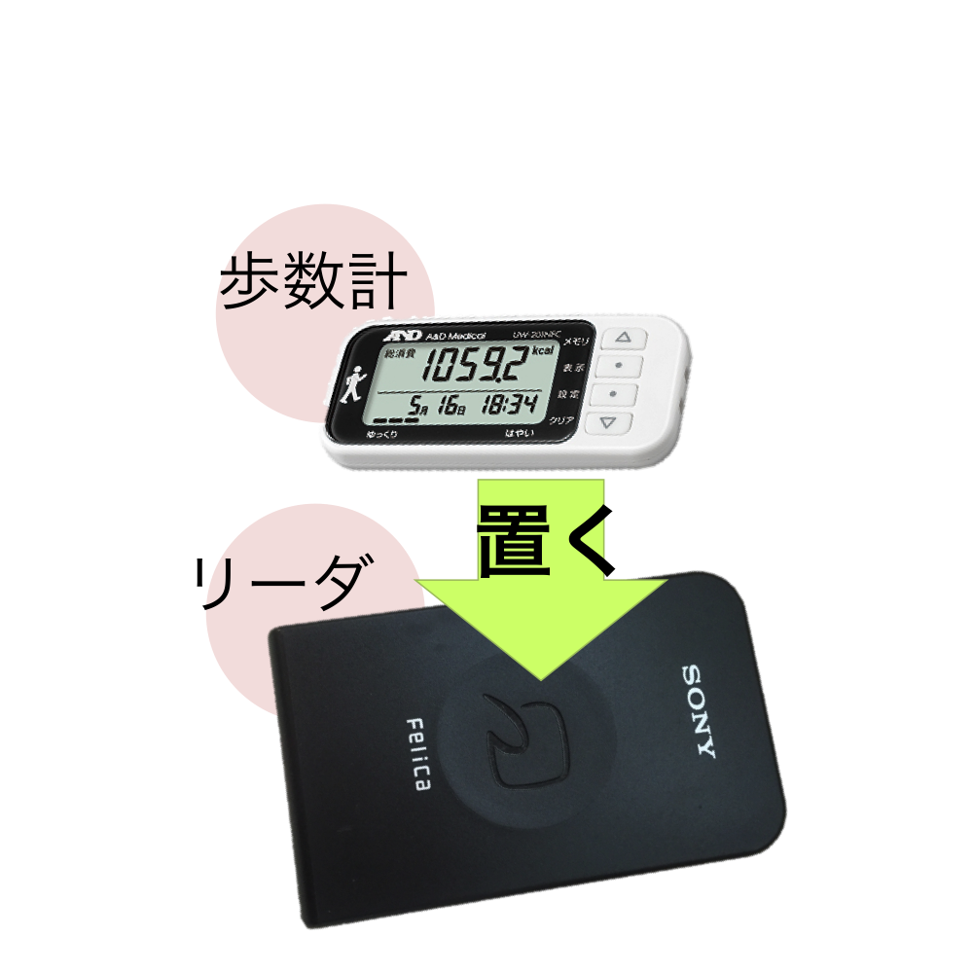
The solution: NFC Pedometer
By using a NFC pedometer we can make this people to enter the event.
No need to buy a expensive device and learn complicated things to use it.
Just carry the device on their pocket and go to registration point once a while.
Using NFC technology we can transfer walking data from pedometer to the event website.

Slide 7
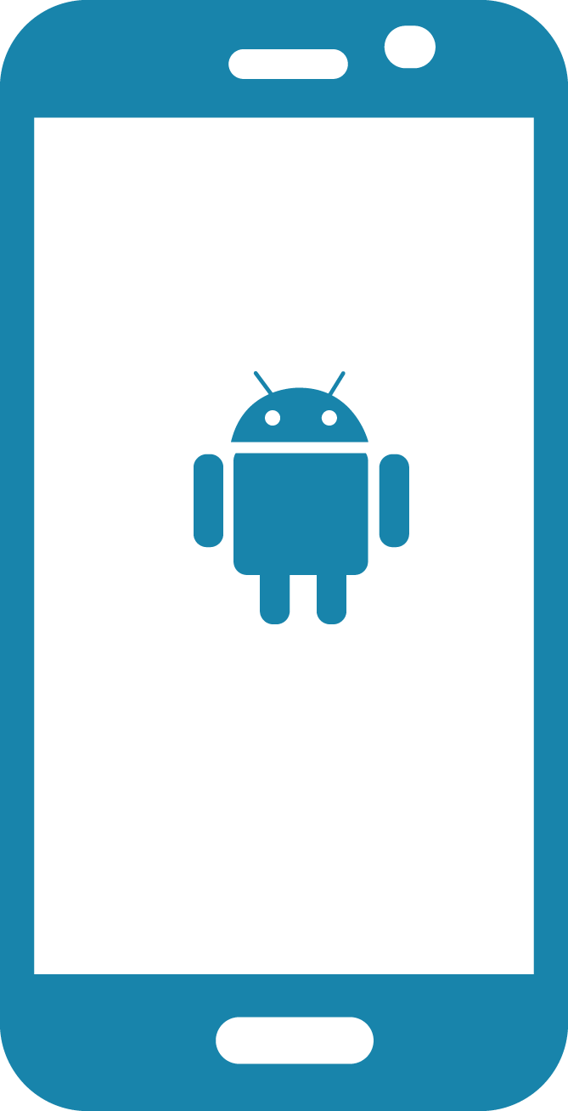



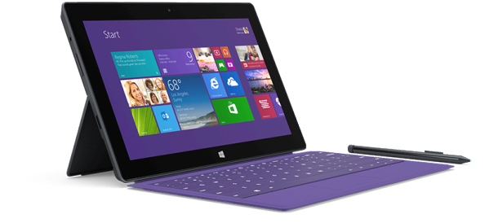
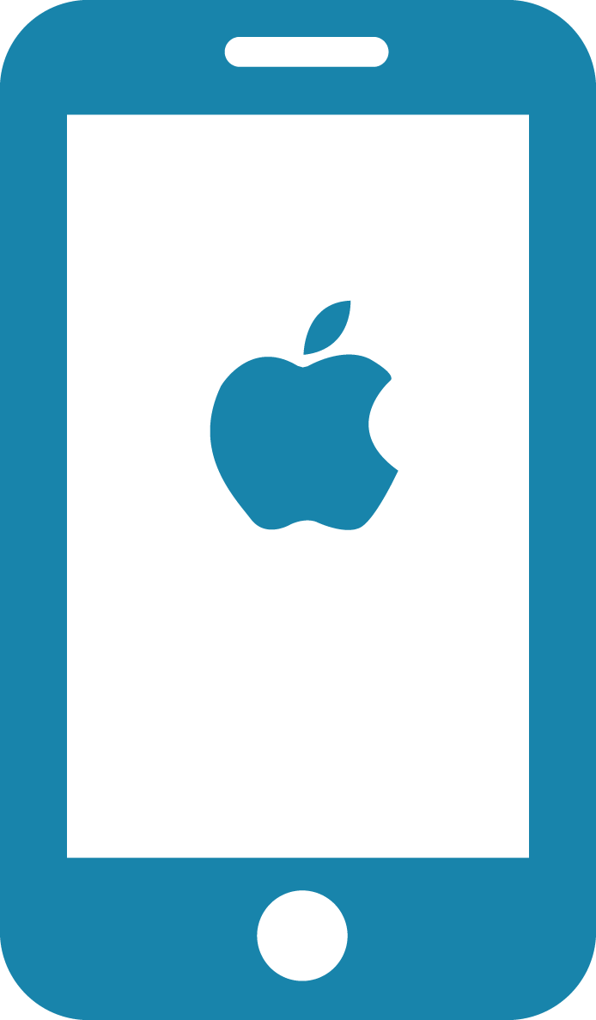
Django
Tekupeko server
Pedometer
Reader
Android
Tekupeko app
Moves Relay App
GIT
Server
Moves
Server
YAML
File
PC app

Slide 8
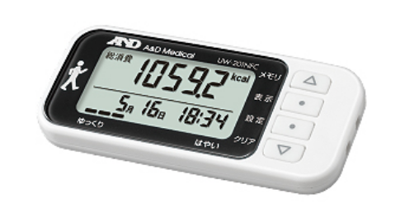
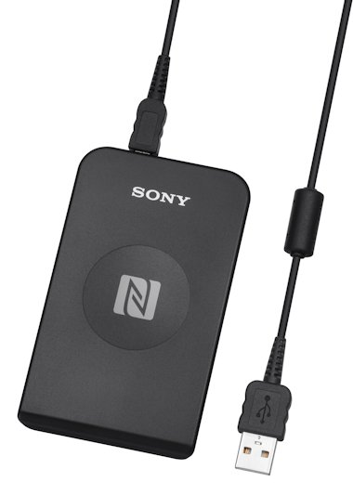
Hardware
NFC Pedometer
A&D Medical UW-201NFC
NFC reader
Sony RC-S380
PC
Windows Surface Pro 3

Slide 9

NFC
NFC (Near field Communication) is the set of protocols that enable electronic devices to establish radio communication with each other by touching the devices together, or bringing them into proximity to a distance of typically 10cm or less
Each full NFC device can work in three modes:
NFC Card emulation mode enables NFC-enabled devices such as smartphones to act like smart cards, allowing users to perform transactions such as payment or ticketing.
NFC Reader/writer mode enables NFC-enabled devices to read information stored on inexpensive NFC tags embedded in labels or smart posters.
NFC peer-to-peer (P2P) mode enables two NFC-enabled devices to communicate with each other to exchange information in an adhoc fashion
Notes:
The first thing to do is understand how NFC works, the type of device and reader we have to work with.
For sony reader and A&D pedometer is needed to understand Felica and Type 3 tag

Slide 10
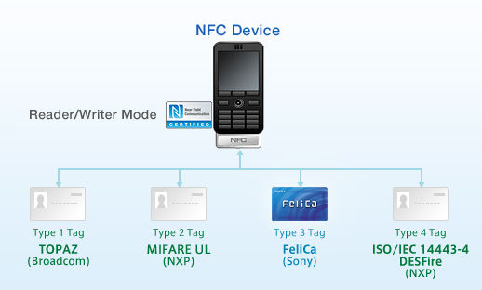
NFC Tags
NFC tags typically contain data and are read-only, but may be rewritable. NFC tags can be custom-encoded by their manufacturers or use the industry specifications provided by the NFC Forum.
NFC Forum defines 4 distinct types of tags that provide different communication speeds and capabilities in terms of flexibility, memory, security, data retention and write endurance.
Type 3 Tag is based on the Japanese Industrial Standard (JIS) X 6319-4. This tag type is pre-configured at manufacture to be either read and re-writable, or read-only. Example: Sony FeliCa

Slide 11
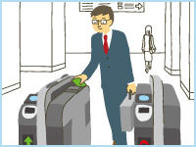
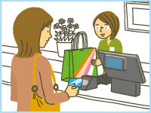
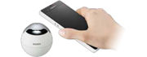
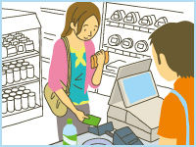
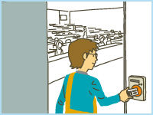
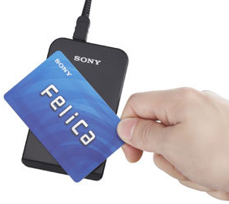

Sony FeliCa & PaSoRi
FeliCa is a contactless RFID smart card system from Sony in Japan, used in e-money, public transportation, and student id cards (ICCOCA, Suica, Manaca, PiTaPa, etc.) as well as in consumer electronics.
The name stands for Felicity Card
Sony has an external USB FeliCa PC reader/writer called PaSoRi. (Sony RC-S380)

Slide 12
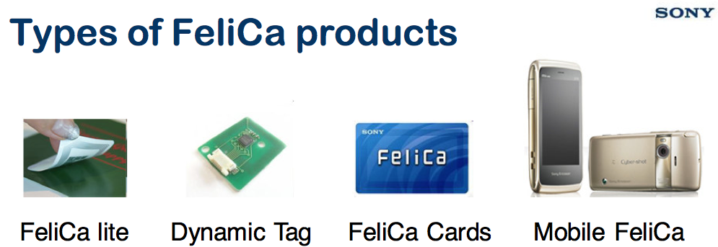
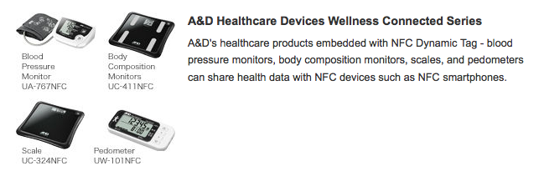
A&D NFC Pedometer
UW-201NFC
Notes:
NFC Dynamic Tag is a wireless-interface product, which can be embedded into electronic devices, enabling the device to communicate with any NFC reader/writer or with any NFC smartphone
http://www.sony.net/Products/felica/casestudy/healthcare.html

Slide 13
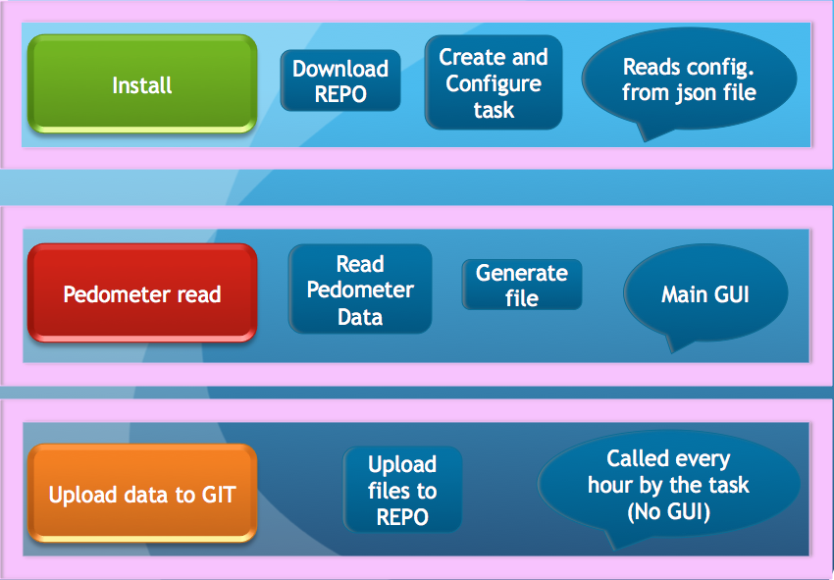
General design

Slide 14
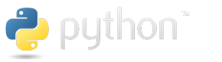



Programing
Python 2.7 & C (Programing language)
NFCPY Library for Python and NFC (open source)
Git (Version Control System) Github server (testing)
Sony NFC Port Software (Driver for RC-S380 freeware)
Sony SDK for NFC Starter Kit (freeware)
Sony NFC Healthcare Library (request and registration to use )

Slide 15
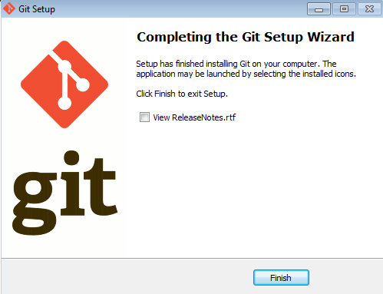
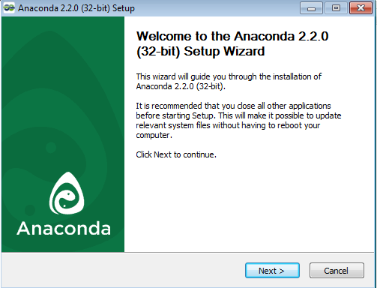
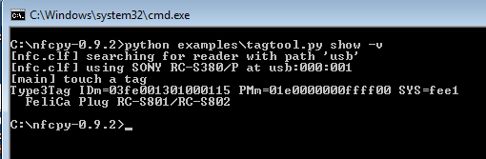
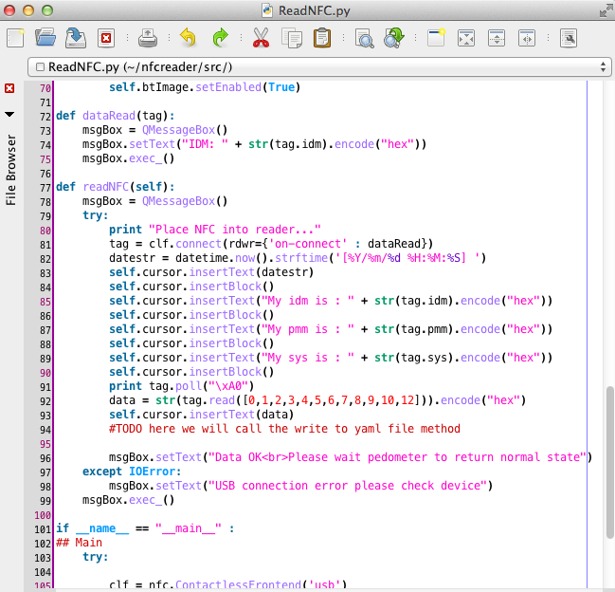
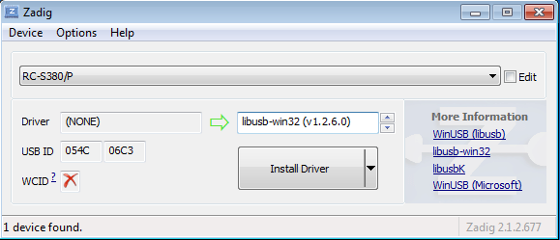
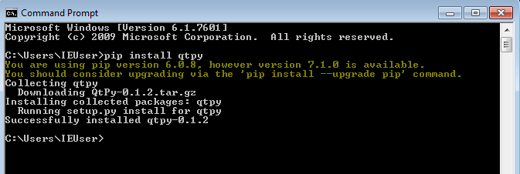
Notes:
Python 2.7 Anaconda Distribution
Python libraries QtPy, pyside,nfcpy, libusb, apscheduler
Git command prompt
NFC usb driver with libusb-win32

Slide 16
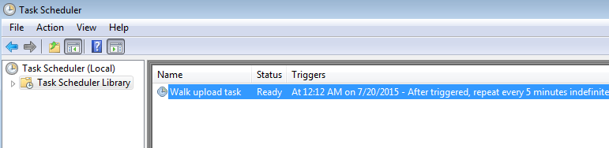
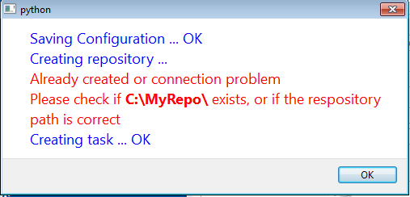
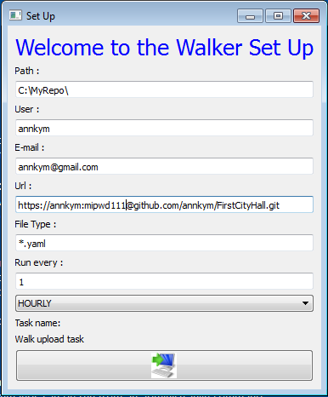
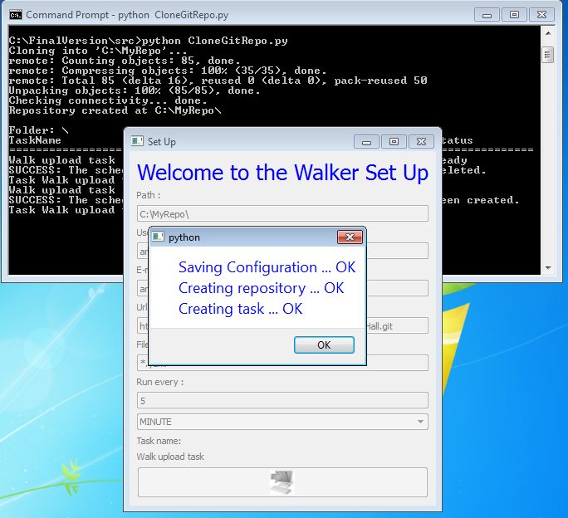

Slide 17
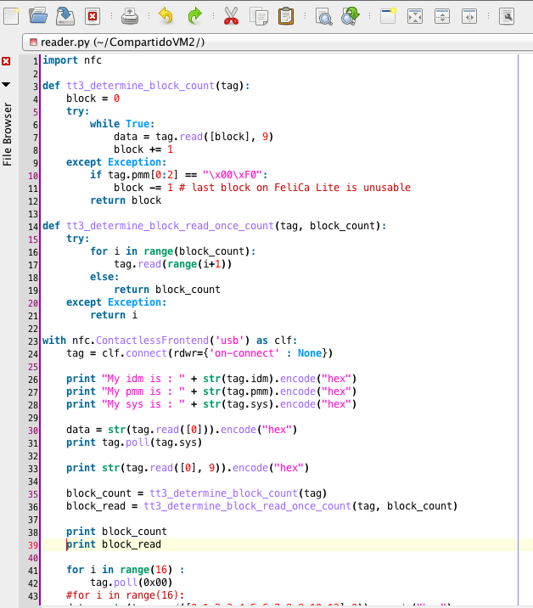
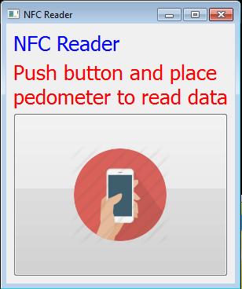

Slide 18
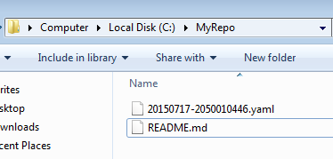
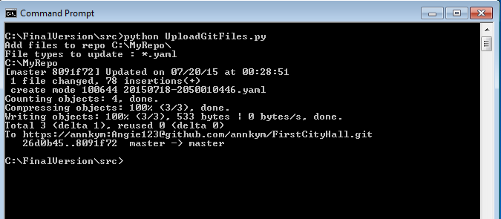
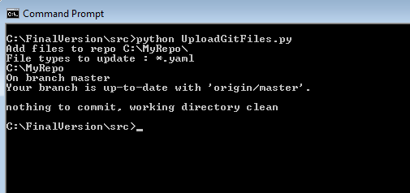
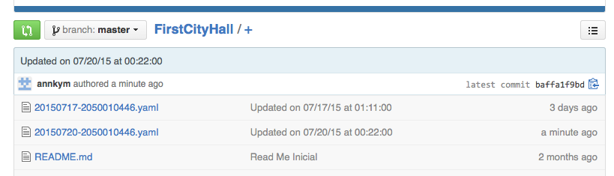

Slide 19
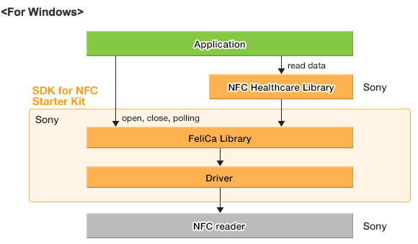
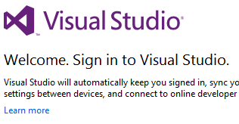
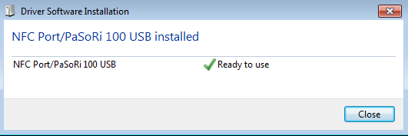
Redesign of reader
Using :
Sony NFC Port Driver
Sony SDK for NFC
Sony NFC Healthcare Library
Programing with C and Visual Studio

Slide 20
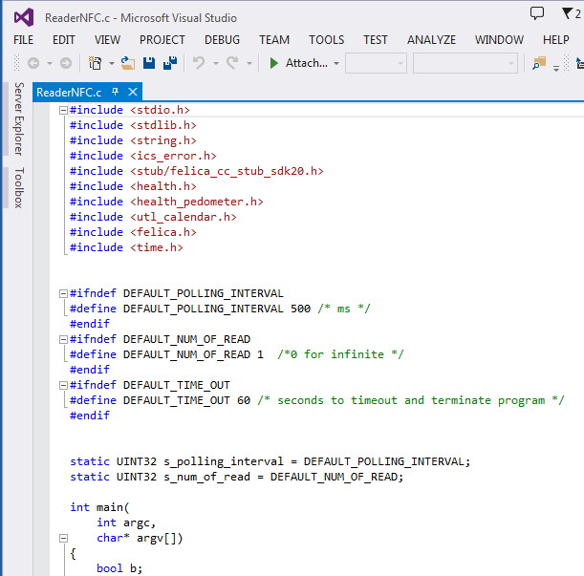
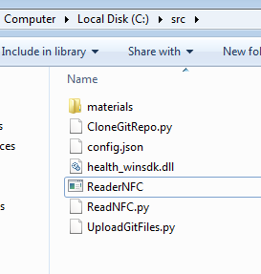
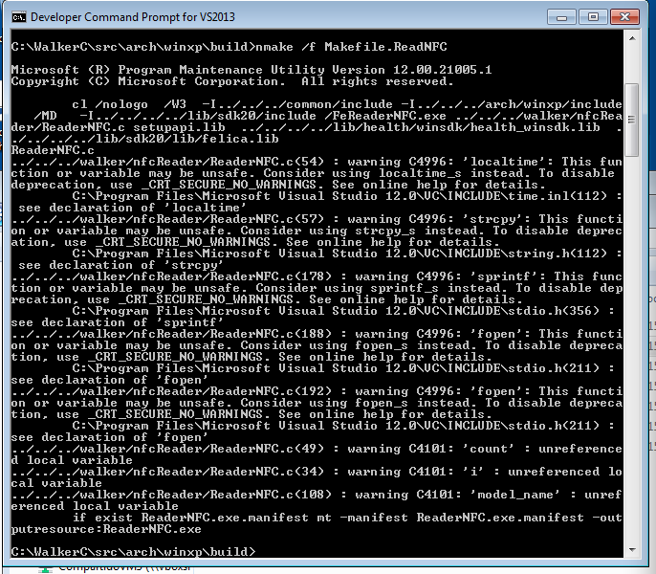
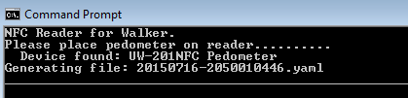

Slide 21
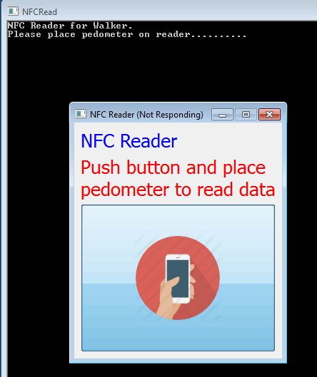
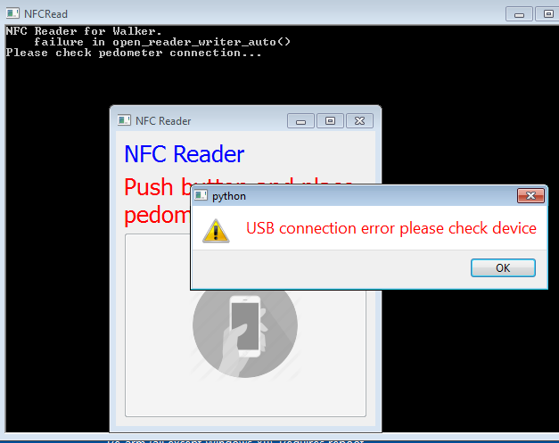
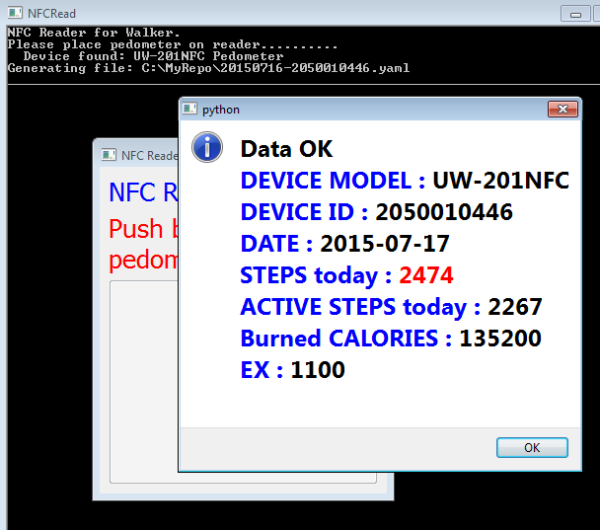
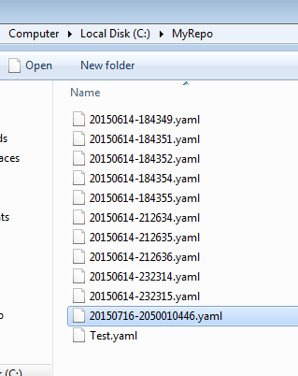

Slide 22
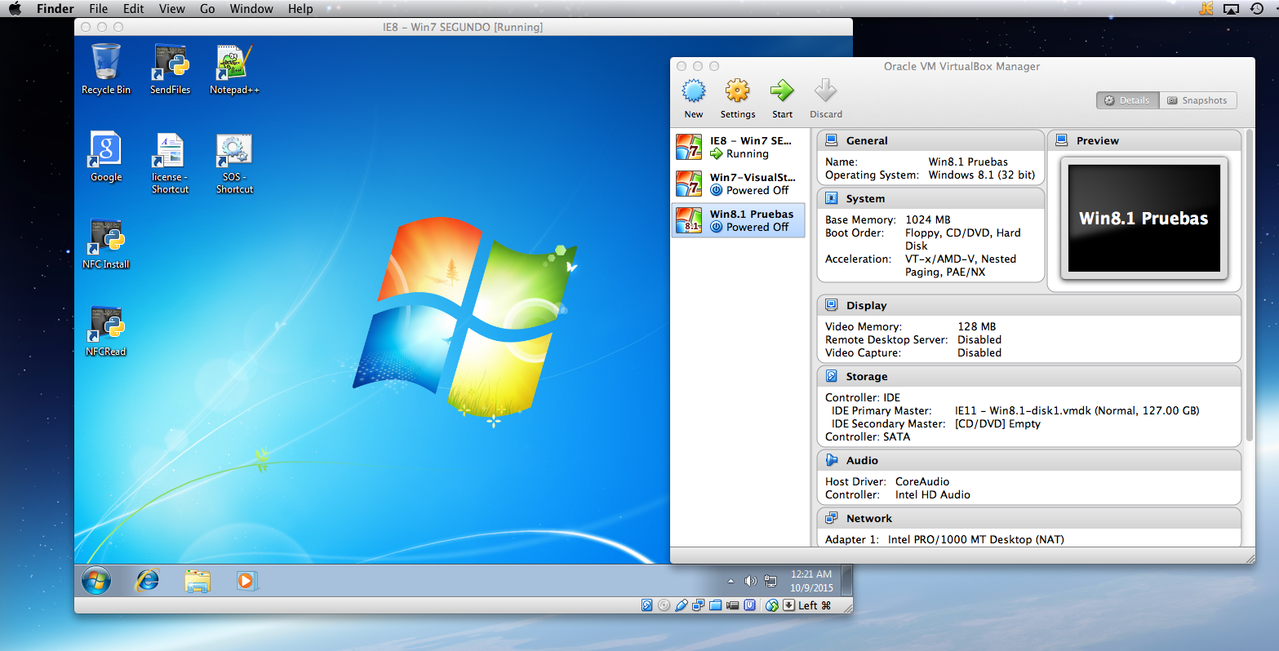



Testing
Virtual box
Virtual machine Windows 7 & 8
Final testing on Windows surface PRO 3 with Windows 8

Slide 23







Final GUI design for walking event

Slide 24

Location Based Social Game for Tourists
Notes:
http://everybodywalk.org/documentary/

Slide 25
Design &Technology
HTML 5
Phonegap
Jquery & Jquery Moblile
Phonegap Build
Google Maps appi for JS

